Slide 1
Python For data science (3150713) Minor-Project
Project Topic : “Visualization and forecasting stocks”
Computer Science & Engineering
CSE-2, 5th Sem
Kansagra Om : 200050131075
Patel Sapan : 210050131513

Slide 2

What is Stocks:
Stocks are of two types—common and preferred. The difference is while the holder of the former has voting rights that can be exercised in corporate decisions, the later doesn't. However, preferred shareholders are legally entitled to receive a certain level of dividend payments before any dividends can be issued to other shareholders.
There is also something called 'convertible preferred stock'. This is basically a preferred stock with an option of converting into a fixed number of common shares, usually any time after a predetermined date.
A stock is a general term used to describe the ownership certificates of any company. A share, on the other hand, refers to the stock certificate of a particular company. Holding a particular company's share makes you a shareholder.

Slide 3

What is Visualization and Forecasting Stocks:
Stock price forecasting is a popular and important topic in financial and academic studies. Share Market is an untidy place for predicting since there are no significant rules to estimate or predict the price of a share in the share market.
Many methods like technical analysis, fundamental analysis, time series analysis, and statistical analysis, etc. are all used to attempt to predict the price in the share market but none of these methods are proved as a consistently acceptable prediction tool.

Slide 4
Problem Statement:
In this Case study, The stock market appears in the news every day. You hear about it every time it reaches a new high or a new low. The rate of investment and business opportunities in the Stock market can increase if an efficient algorithm could be devised to predict the short term price of an individual stock.
Previous methods of stock predictions involve the use of Artificial Neural Networks and Convolution Neural Networks which has an error loss at an average of 20%.

Slide 5
Dataset Description :
In this Case study, we used the Apple Community stock Dataset from 2021-Nov. to 2022-Nov.
In this dataset we have the open , High , Low , Close , Adj close , Volume , price of stock by day wise.
This dataset referred from the Yahoo finance
Dataset Link : https://finance.yahoo.com/quote/AAPL/history/
Website : https://finance.yahoo.com/

Slide 6
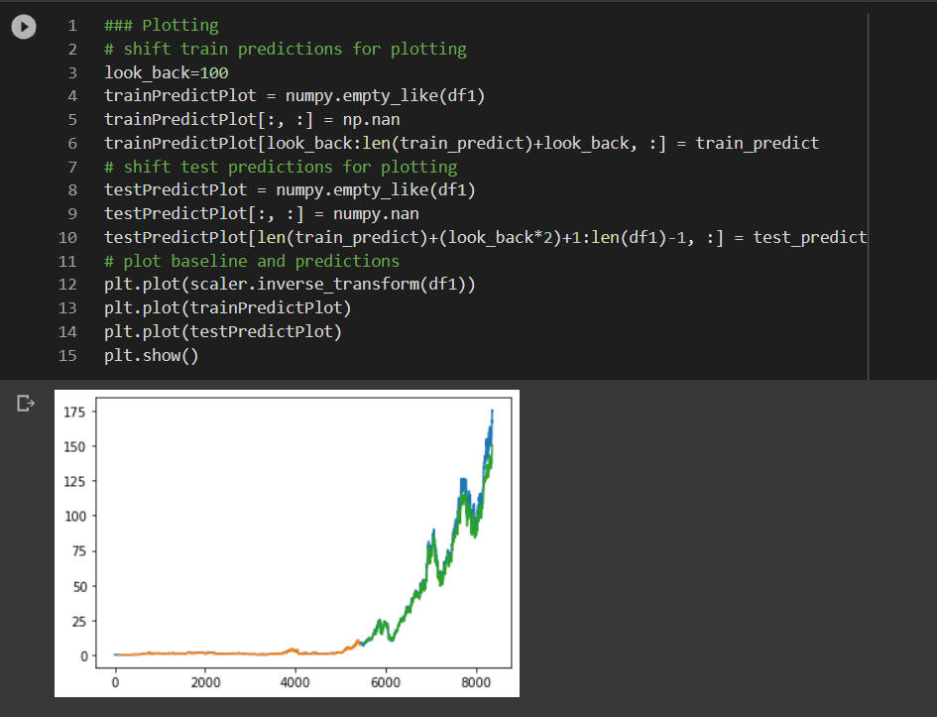
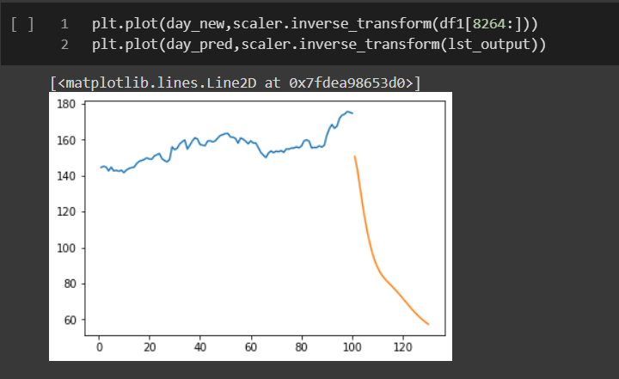
Result :
Test Data prediction Graph :
This the New 30 Days Output :

Slide 7
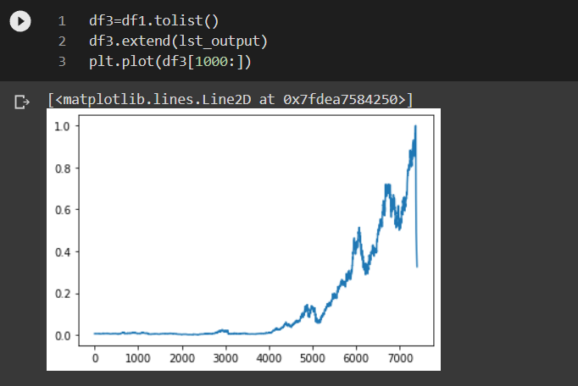
Result :
This the Complete 30 Days predicted Output :

Slide 8
Conclusion:
Comparing the benchmark model - Linear Regression to the final improved LSTM model, the Mean Squared Error improvement was significant.
The mean balancing done over processed LSTM helped us get better results and more accurate patterns over hysterical data sets. Predicting stock market prices is a risky trend and can often lead to inaccurate value predictions mainly because of how many factors it depends upon. This project can be extended and modified in future by training the model on more features and including some important nonnumerical features as well with the help of a subject matter expert.

Slide 9


